Slide 1
Course “Instrumentation” Master Degree Program “Advanced Manufacturing” Winter semester 2024/2025
Group-1
Smart Posture Monitoring and Feedback System
Supervised by:
Prof. Dr.-Ing Stephan Odenwald
Mr. Christoph Warnat
Name: Mtr. No. Ankit Wala 807436
Akash Deshpande 805445
Prajjwal Garag 812210
Pratik Dhulap 807759
Sushant Shetty 812096

Slide 2
Project Outline
Introduction
Problem statement
Importance of Proper Postures in Manual Lifting
Implementation and Approach
Analysis
Risk Classification
Selection of Microbit as Sensor
Sensor Placement
Body Posture Angles
Data Processing and Feedback Mechanism
Results
Conclusion and Future Scope
Bibliography

Slide 3
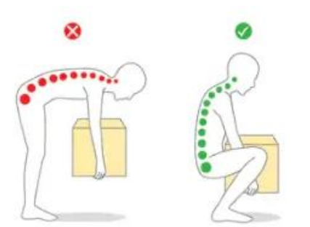
Problem Statement
The task is to provide a measurement system, which is suited to analyze the movement of a worker in such a way, that he/she can be informed/warned if the box is lifted in an unhealthy or even dangerous way.
Group-1 : Measure the angle of the shoulder area using accelerometers placed on the back of a test subject
Fig 1: Effect on the Back bone due to incorrect box lifting

Slide 4
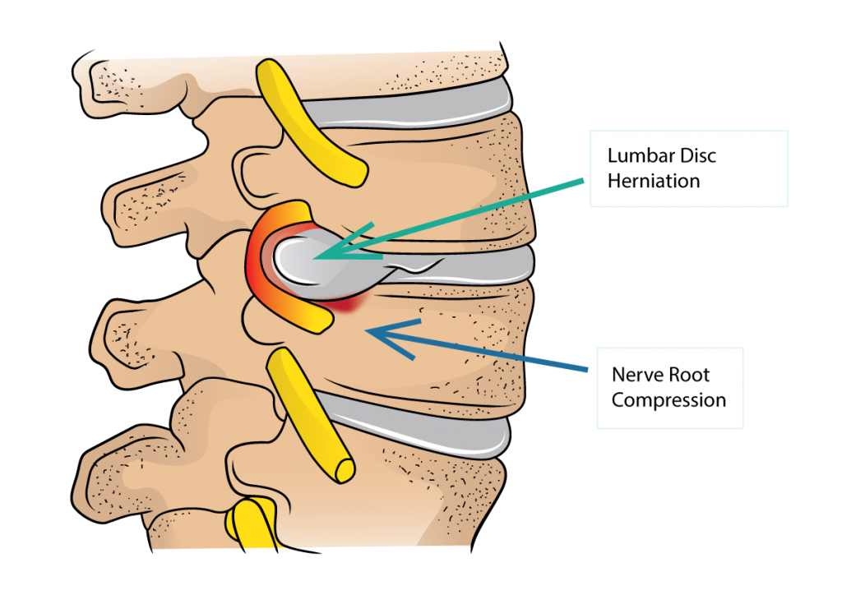
Importance of Proper Postures in Manual Lifting
Improper lifting leads to:
Severe Risks: Herniated discs, spinal fractures.
Moderate Risks: Chronic low back pain, facet joint strain.
Low Risks: Muscle strain, fatigue.
Affected areas:
Lumbar vertebrae (L1-L5).
Sacroiliac joints.
Thoracic spine.
Cumulative low back load (CLBL) is a major cause of injuries.
Fig 2: Disc Herniation in the spine Source: drleespine.com.au

Slide 5
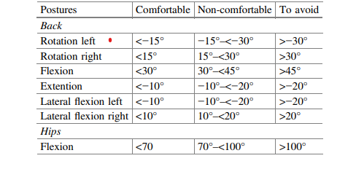
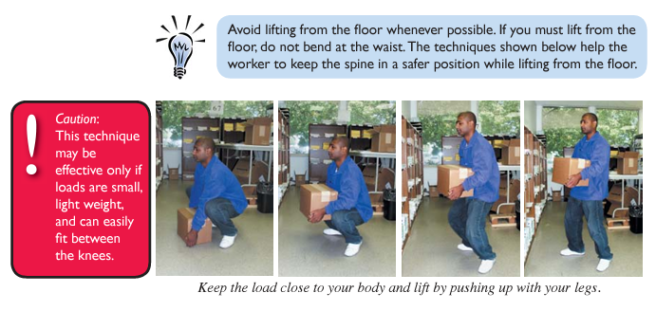
Implementation and Approach
Analysis
Table 2: Risk Zone of Body angle while lifting the weight
Table 1: Body angle analysis [3]
Table 1 outlines the range of motion for back and hip angles categorized into three zones: Comfortable, Non-comfortable, and to Avoid [3].
This concept was adapted into the ergonomic suit design, incorporating sensor technology to track posture and angle ranges.
Using a trial-and-error approach with multiple iterations and practical tests, the data was refined.
Table 2 represents the finalized angle ranges, divided into three risk zones: Low Risk, Moderate Risk, and High Risk, ensuring accurate ergonomic risk categorization.
Fig 3: Proper lifting of box (Guidelines for Manual Material Handling) [2]

Slide 6
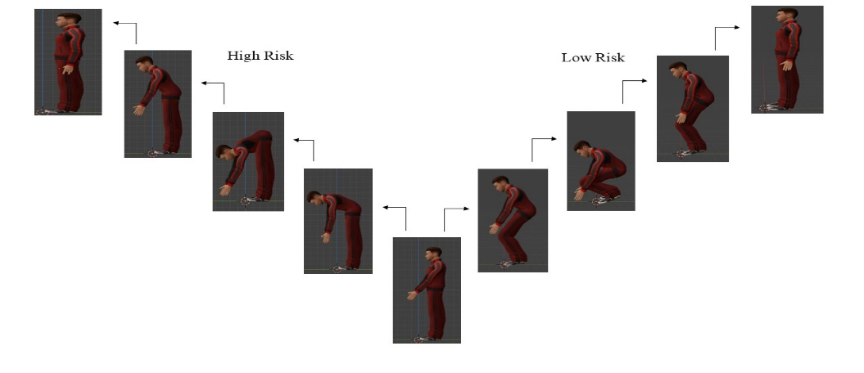
Implementation and Approach
Risk Classification
Risk Classification and Case Derivation:
Four critical body angles were analyzed: Arm Angle, Back Angle, Knee Angle, and Back Arch Angle.
Each angle was categorized into three risk zones: Low, Moderate, and High.
Combining these risk zones across the four angles resulted in 81 unique cases, as shown in Table 3.
Fig 4: High risk and Low risk process flow (Source: Blender)
Table 3: 81 unique Cases derived from four angles and 3 risk zones

Slide 7
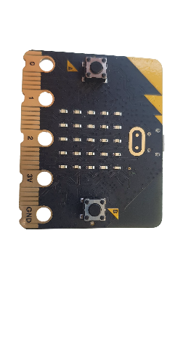
Selection of Microbit as Sensor
Fig 5: Generic Micro bit used in the project
Fig 6: Working principle of accelerometer Source: makeagif.com
Selection Criterion for the Sensor
Integrated 3-axis MEMS accelerometer for motion tracking and posture monitoring
Sampling rate of approximately 33 Hz ideal for human movement analysis as frequencies remain below 10 Hz.
High sensitivity range of ±2 g with 1 mg/digit resolution for precise measurements
Wide response bandwidth from 0.5 Hz to 1.6 kHz ensures comprehensive motion capture
Compact size, wireless communication, and Python programmability for easy integration

Slide 8
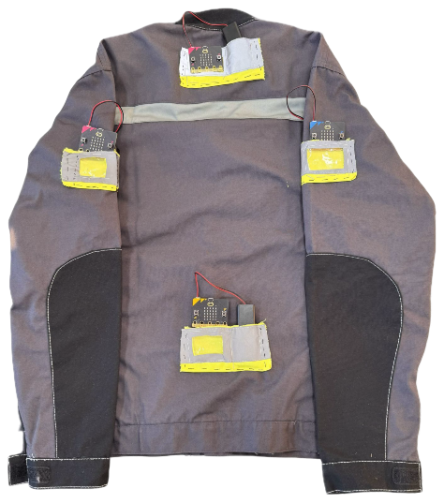
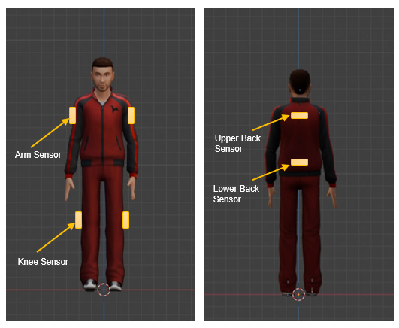
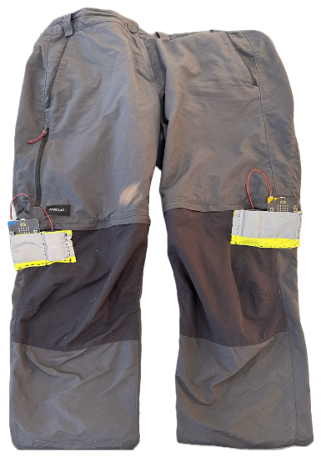
Sensor Placement
Six Microbit sensors are placed on arms, back, and knees to monitor posture.
Sensors transmit real-time data via radio frequency to a Python program for angle calculation.
A feedback system alerts users via LEDs and buzzers when posture risks are detected.
Risk levels are classified as No Risk, Low, Moderate, or High.
Fig 8: Sensors on the Jacket and trousers
Fig 7: Position of Sensors on the Human Body

Slide 9
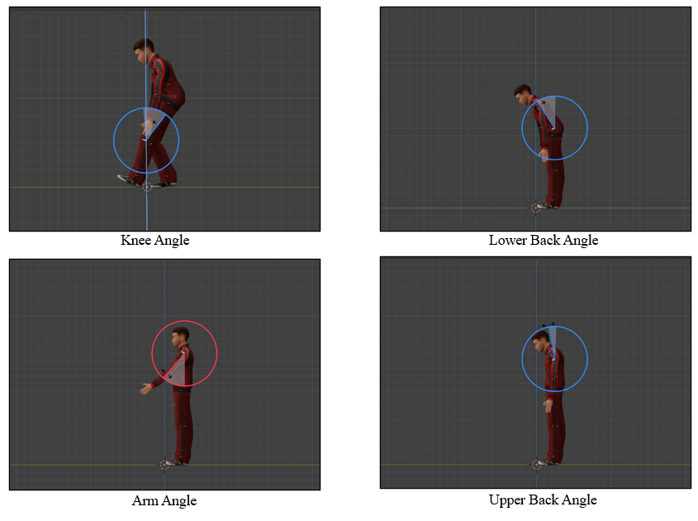
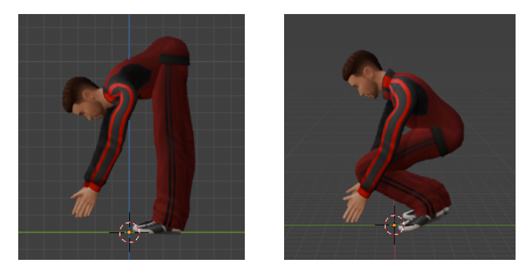
Body Posture Angles
Angles to be Measured and Sensor Placements on the Body
Arm Angle: Tracks arm movement and elevation to identify overreaching or strain.
Back Angle: Monitors torso tilt to detect improper bending postures.
Knee Angle: Measures knee flexion to ensure proper bending techniques.
Back Arch Angle: Difference between lower and upper back angles to assess spinal curvature.
Fig 10: Wrong body posture vs Correct body posture for lifting Source: Blender
Fig 9: Illustration of four angles which are being measured

Slide 10
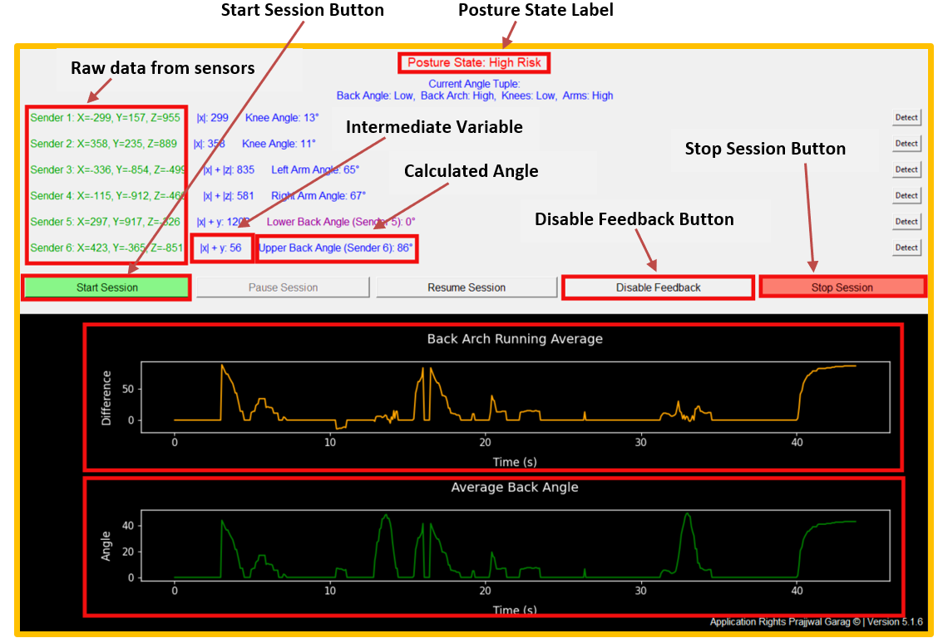
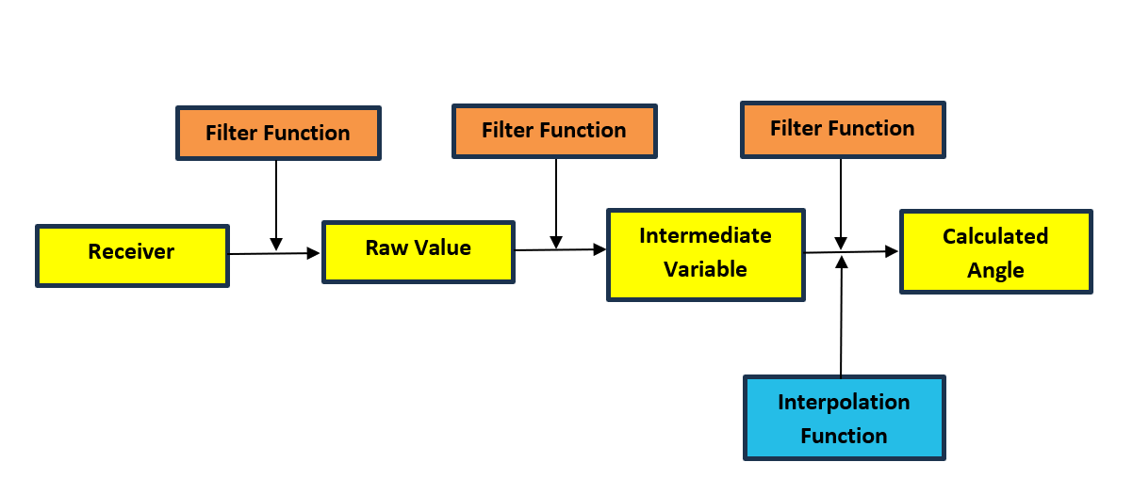
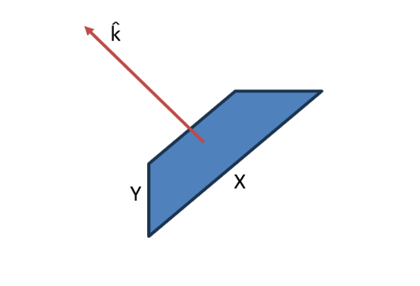
Data Processing and Feedback Mechanism
Fig 12: Data Processing Flow: From Sensor Input to Calculated Angles
Fig 11: Posture Monitoring GUI with Real-Time Data and Risk Feedback
Calculation of Intermediate Parameter
Mixed Acceleration Data: Raw sensor outputs cm/s² are distributed across all three axes, resulting in mixed readings when attached to the body.
Intermediate Variable Calculation: An intermediate parameter is calculated by aligning a plane orthogonal to the body's surface and measuring perpendicular acceleration.
Enhanced Measurement Accuracy: This approach enables accurate angle measurements relative to body-oriented planes, improving precision and relevance.
Fig 13: Calculating Perpendicular Acceleration Along k̂ for Accurate Angle Measurements Relative to Body Surface

Slide 11
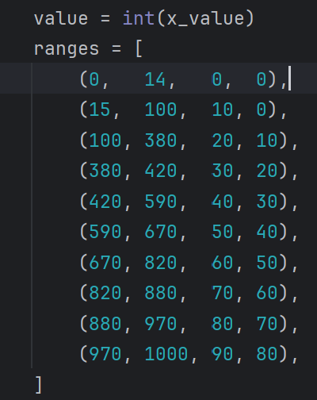
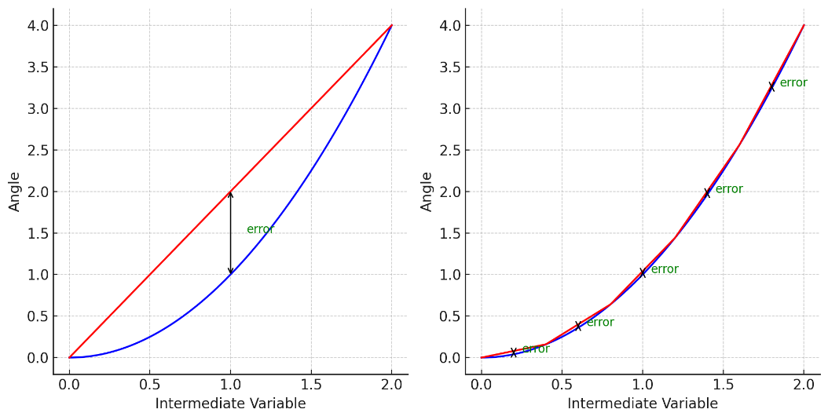
Data Processing and Feedback Mechanism
Low pass filter: Filtered_value = (alpha) x (New_value) + (1 - alpha) x (Previous_value)
Implements a low-pass filter by averaging new inputs with previous filtered values to reduce high-frequency noise.
The smoothing factor alpha (0 to 1) adjusts responsiveness: high alpha for quick changes, low alpha for greater smoothing.
Each filtered value serves as the previous value for the next input, ensuring gradual and stable signal transitions.
Fig 14: Low-pass filter function
Interpolation Function
Non-Linear Mapping: Uses interpolation to map intermediate variables to calculated angles due to the non-linear relationship.
Experimental Data Integration: Incorporates additional intermediate values from physical measurements to minimize mapping errors.
Enhanced Accuracy: Significantly reduces calculation errors, ensuring angles closely match actual measurements.
Fig 15: Interpolation Function
Fig 16: Reduction of approximation error due to improve interpolation function, red graph indicates interpolation function and blue graph indicates actual variation.

Slide 12
Data Processing and Feedback Mechanism
Feedback Loop:
Real-time alerts for prolonged moderate or high-risk postures:
a. Moderate Risk: Alert after 10 seconds.
b. High Risk: Alert after 5 seconds.
Alerts:
Audible (440 Hz buzz)
Visual (LEDs).

Slide 13
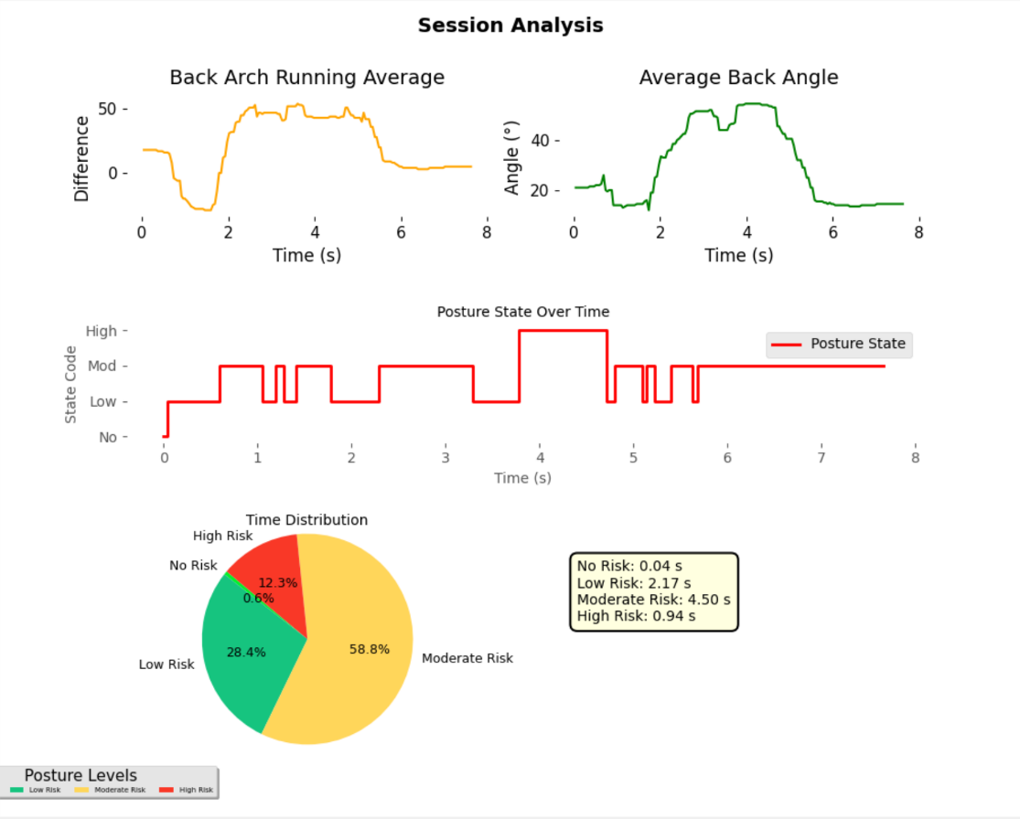
Results
Session Data Analysis: Graphs displayed upon pressing the "Stop Session" button.
Key Graphical Outputs:
Back Arch Running Average and Average Back Angle.
Posture State Over Time Graph
Posture Analysis Visualizations: Pie Chart, Detailed Metrics Box
Ergonomics Insights: Comprehensive understanding of posture dynamics.
Fig 17: Posture Analysis Visualizations
Fig 18: Back Posture Analysis Visualizations
Fig 19: Posture State Over Time

Slide 14
Conclusion and Future Scope
Conclusion:
The system successfully monitors posture and reduces ergonomic risks.
Real-time feedback encourages safer lifting techniques.
Visual data supports workplace safety improvements and productivity.
The project demonstrates the potential for injury prevention through technology.
Future Scope:
Add advanced sensors like gyroscopes for detailed motion tracking.
Use AI to predict injuries based on posture data.
Implement cloud storage and mobile access for remote monitoring.
Customize the system for industries like healthcare and logistics.

Slide 15
Bibliography
Schneider, E., & Irastorza, X. (2010). Work-related musculoskeletal disorders in the EU. European Agency for Safety and Health at Work, Luxembourg: Publications Office of the European Union.
Ergonomic-Guidelines-for-Manual-Material, https://www.cdc.gov/niosh/media/pdfs/Ergonomic-Guidelines-for-Manual-Material-Handling_2007-131.pdf
Hermien Matthys, Willy Bohets, Veerle Hermans, Effectiveness of Specific Lifting Techniques and Tools on Workload in a Lifting Situation – A Case Study: Volume I: Healthcare Ergonomics, https://www.researchgate.net/publication/326903553
P Paul FM Kuijer, Jos HAM Verbeek, Bart Visser, Leo AM Elders, Nico Van Roden, Marion ER Van den Wittenboer, Marian Lebbink, Alex Burdorf, Carel TJ Hulshof1, An Evidence-Based Multidisciplinary Practice Guideline to Reduce the Workload due to Lifting for Preventing Work-Related Low Back Pain https://doi.org/10.1186/2052-4374-26-16
Nicholas B Washmuth, Abby D McAfee, C Scott Bickel, Lifting Techniques:Why Are We Not Using Evidence To Optimize Movement?, https://doi.org/10.26603/001c.30023

Slide 16
THANK YOU

